Slide 1
LEAD SCORING
CASE STUDY
By,
SRINIJA

Slide 2
Problem statement and Case Objective
Problem statement: X education sells online courses to industry professionals and gets lots of leads wherein the lead conversation rate is poor. To make this process more efficient the company wishes to identify the most potential leads. If they identify this , conversion rate might increase and also sales team can focus on communicating with the potential leads.
Objective: X education business company wishes to identify most potential leads.
Company requires a model where in based on lead score they can find the conversion chances of becoming lead from among the customers. So that their sales team can approach them on lead conversion.
Exploratory data analysis and Logistic regression model to be used on the case study to identify the patterns which finds the promising leads.
Data: Leads.csv
Note: Clear information of analysis can be seen in Python (Jupyter notebook file in Zip)

Slide 3
STEPS
Data cleaning & Manipulation:
Load and verify the data.
Analyse missing values from data and drop the unnecessary columns which are more than 30-40% of missing values.
Replace ‘Select’ value(consists in dropdown) with Nan.
Impute the missing values accordingly to data for proper analysis. Handle outliers in data.
EDA:
Perform Univariate and Bivariate analysis on categorical and numerical variables.
Analyse required variables along with Target data.
Drop the unnecessary columns.

Slide 4
STEPS
Scaling and Data Preparation:
Create dummy data for categorical variables and merge with main dataset.
Splitting the data into train and test dataset .
Perform scaling on dataset using StandardScaler.
Model building:
Used RFE method since with corr() unable to find highly corelated variables.
Used Logistic regression classification technique for model making and prediction.
Model Evaluation:
Calculated various evaluation metrics like Accuracy, Precision, Sensitivity(recall), Specificity, F-score.

Slide 5
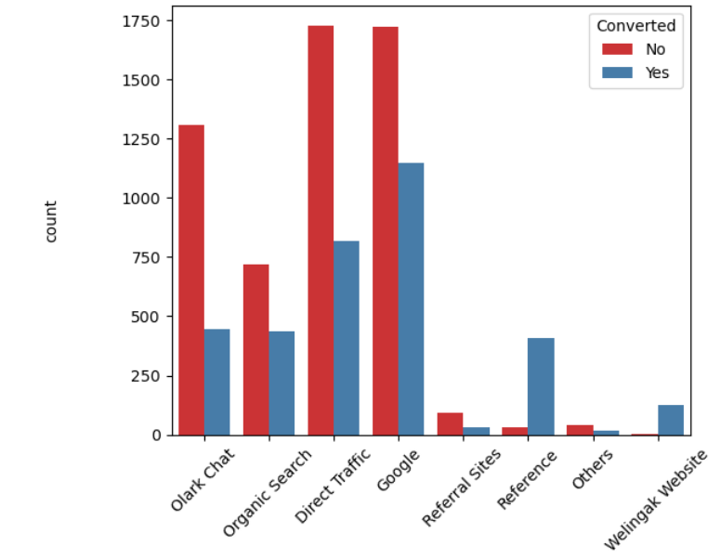
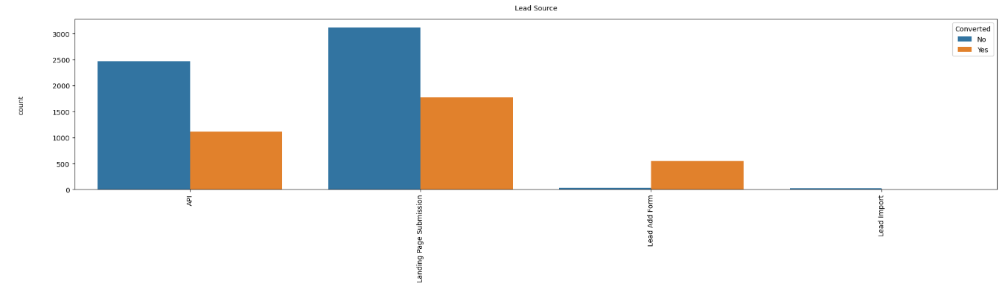
Data preparation & EDA
Imputed missing values for the variables which has high value percentage of category.
Lead conversion rate is ~38%. Target variable ‘Converted’.
Started analysis with count plot on category variables (Lead source, Lead origin, Do not email, Do not call) against Target variable. Lead source
Lead_origin

Slide 6
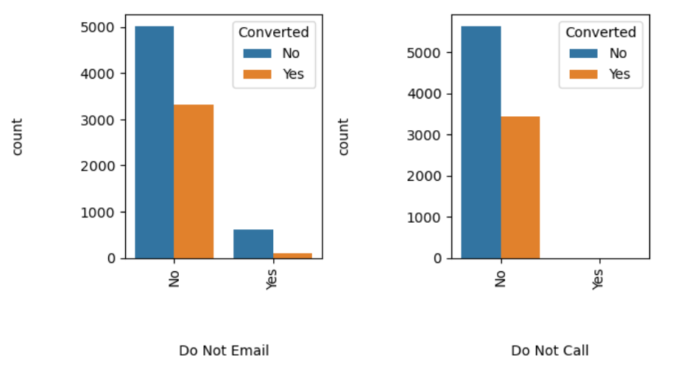
EDA(Contd..)
Converison rate for both variables is less so this cannot be used for analysis.

Slide 7
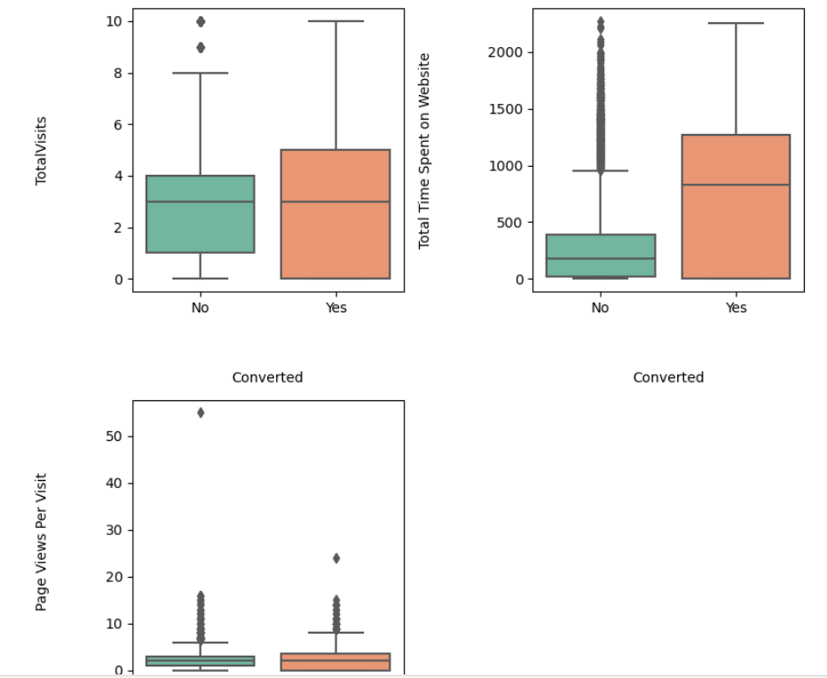
EDA(Contd..)
Numeric variables(TotalVisits ,Total Time Spent on Website,Page Views Per Visit) analysis performed against target variable using box plots.

Slide 8
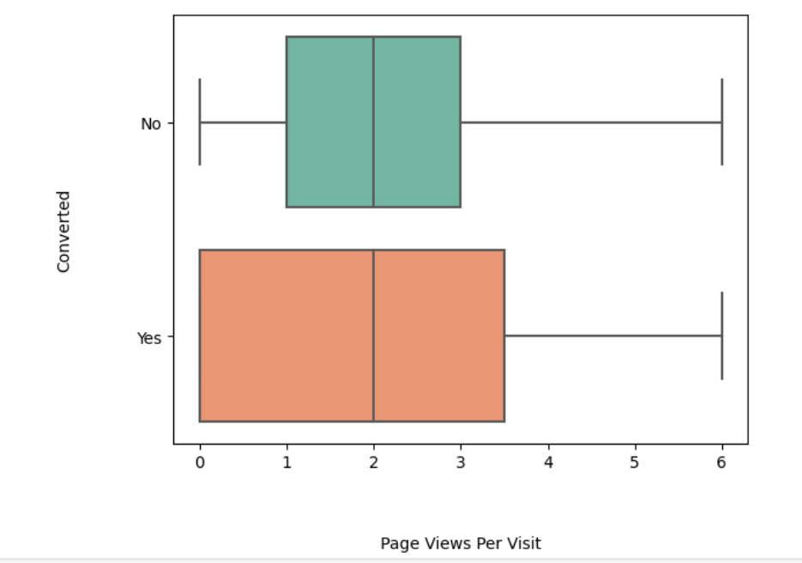
EDA(Contd..)
After removing outliers on ‘Pages view per visit’ using quantiles of 95% . Median is same for both conversion and nonconversion.

Slide 9
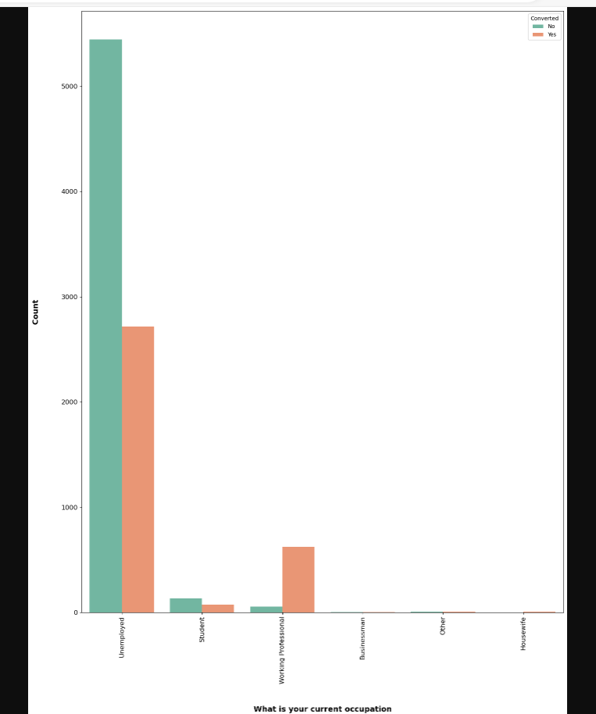
EDA(Contd..)
Other category variables were used fro analysis against Target variable. Specialization has more conversion rates for ‘working professionals’.

Slide 10
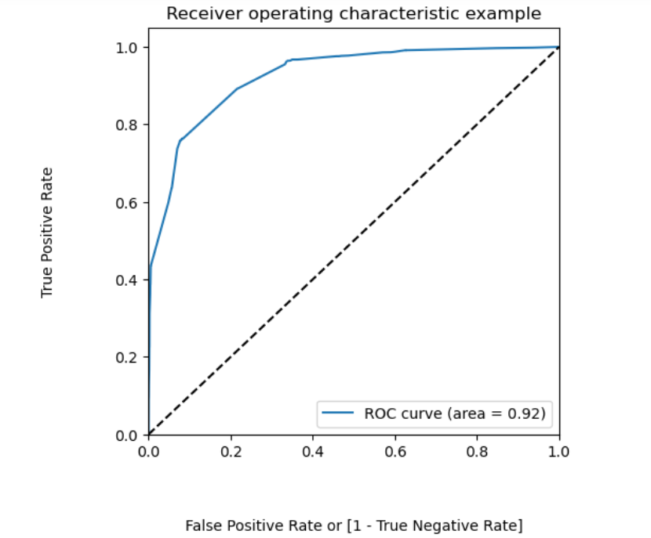
Model preparation
Created dummy data for variables ('Lead Origin', 'Lead Source', 'Last Activity', 'Specialization','What is your current occupation','Tags','City’) and merged with main dataset.
Train test split is performed with 70:30 ratio.
Logistic regression classification method used for model building. ROC curve
Used RFE to choose top 15 variables
and predicted the curve with Target
‘Converted’ and Probability of Converted.

Slide 11
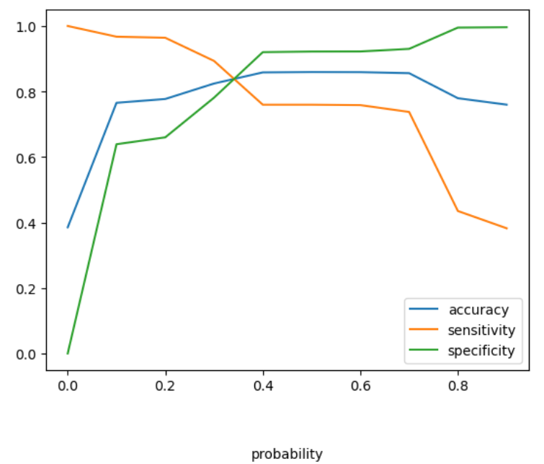
Model building(contd..)
Calculate accuracy sensitivity and specificity for various probability cutoffs from 0-9%
Optimum point found at 0.37.
Optimal cut off

Slide 12
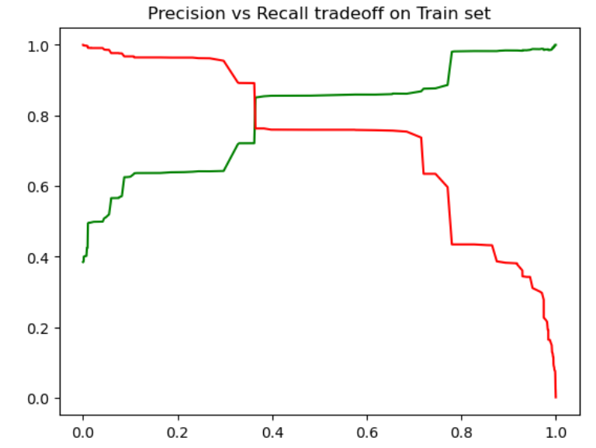
Model building(contd..)
Using confusion matrix metrics were calculated on train data set.
Accuracy: 85.94%
Sensitivity_train: 71.88%
Specificity_train: 92.12%
Precision: 85.9%
Recall: 75.96%
Precision Recall Trade off is performed with positive thresholds.

Slide 13
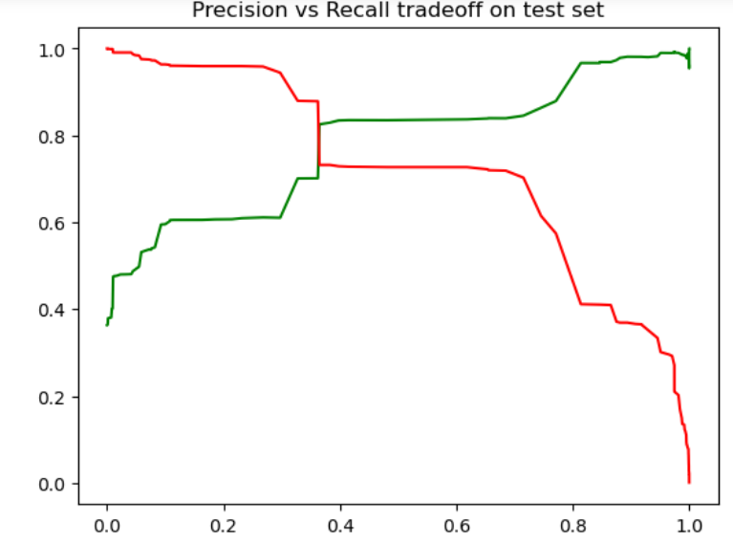
Model building(contd..)
Analysis & Scaling on Test data set is performed . Precision and recall trade off is performed.
Below are test metrics values for test data set.
Recall_test: 82.93% , Specificity_test: 85.68% , Test set Accuracy: 84.8% .

Slide 14
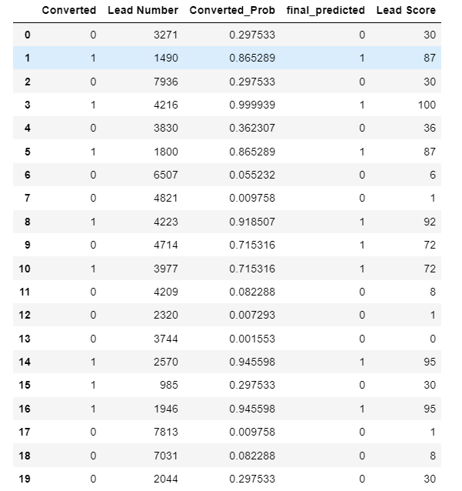
Model building(contd..)
Lead Score assignment to the Predicted values is calculated based on Lead Number. So sales team can check this data in order to follow up on Promising leads.

Slide 15
SUMMARY
Logistic regression here is used to find the probability of conversion of customer.
Model is looking good with significant P , VIF and Coefficient values.
Final model is built with 13 features.
Optimum cut off is 0.37 so any lead greater than this value is probability of converting is predicted as protential lead and less than this probability of cutomer who will not convert.
The top 5 variables in final model are Tags_close by horizon, Tags_will revert after reading the email, Lead source_Welingak website, Last activity_had a phone conversation, Last ativity_SMS sent.
Sensitivity value is good this means the prediction of lead conversion is true
Sensitivity_train: 71.88% , Specificity_train: 92.12% , Train set Accuracy: 85.94% .
Recall_test: 82.93% , Specificity_test: 85.68% , Test set Accuracy: 84.8% .

Slide 16
THANK YOU

